Slide 1
AI‑Powered Resume Screening & Candidate Ranking Platform
Accelerating Talent Evaluation with Intelligent Automation
Presented by: CK
Location: Brisbane, Australia

Slide 2
Problem Statement
Traditional resume screening is slow, inconsistent, and resource‑intensive. Recruiters face challenges such as:
High volume of applicants
Manual review taking hours per role
Inconsistent scoring between reviewers
Difficulty extracting structured insights from unstructured resumes
Limited visibility into candidate strengths and gaps

Slide 3
Our Solution
An end‑to‑end AI‑driven resume evaluation pipeline that:
Extracts job criteria from any JD
Evaluates resumes against structured requirements
Scores candidates objectively
Ranks applicants based on fit
Provides transparent justification and insights

Slide 4
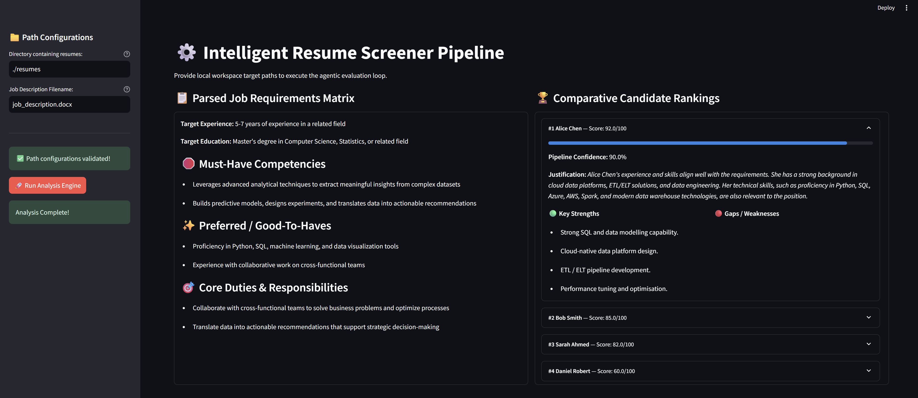
Screenshot 1

Slide 5
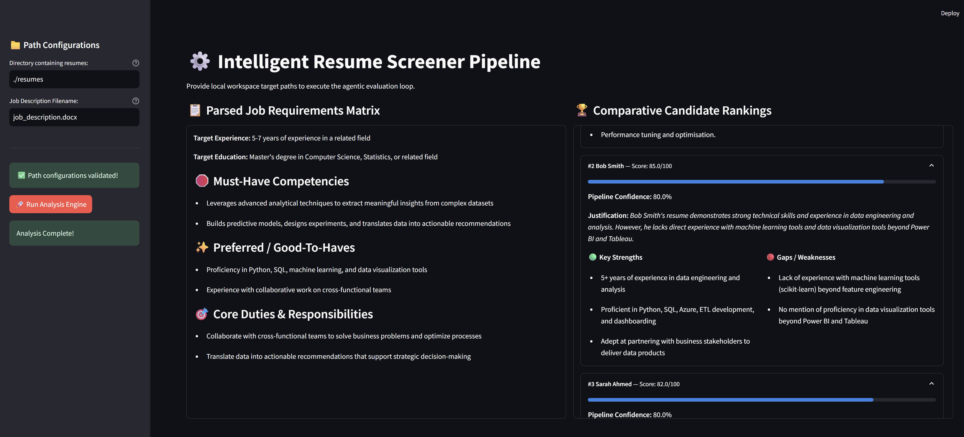
Screenshot 2

Slide 6
High‑Level Architecture
Two‑tier production architecture:
Frontend: Streamlit UI for uploading files and viewing results
Backend: FastAPI service handling LLM processing, scoring, and ranking
LLM Engine: Ollama running Llama 3.1 for local, secure inference
Parallel Processing: Multi‑threaded evaluation for speed
Containerized Deployment: Docker + GitHub Actions CI/CD

Slide 7
Key Features
Automated JD parsing
AI‑powered resume scoring
Weighted criteria evaluation
Transparent strengths & weaknesses
Candidate ranking dashboard
Secure document handling
Windows‑safe PDF/DOCX processing
Fully containerized for deployment

Slide 8
Job Description Analysis
The system automatically extracts:
Must‑have skills
Good‑to‑have skills
Experience requirements
Education level
Key responsibilities
Weighting model for scoring
This ensures consistent evaluation aligned with the role.

Slide 9
Candidate Evaluation Engine
Each resume is evaluated using:
Structured criteria
LLM‑based semantic understanding
Category‑level scoring
Overall fit score (0–100)
Confidence score
Strengths & weaknesses summary
Justification text
Parallel processing ensures fast turnaround even with many resumes.

Slide 10
Ranking & Insights
The platform produces:
A ranked list of candidates
Score breakdowns
Fit justification
Strengths & gaps
Visual progress indicators
This helps hiring managers make informed decisions quickly.

Slide 11
Technology Stack
Frontend: Streamlit
Backend: FastAPI
LLM Runtime: Ollama (Llama 3.1)
Orchestration: Docker, docker‑compose
CI/CD: GitHub Actions
Document
Processing: PyMuPDF, docx2txt
Parallelism: ThreadPoolExecutor

Slide 12
Deployment Options
Local workstation
On‑prem servers
Cloud VM (Azure, AWS, GCP)
Kubernetes cluster
Docker Compose for small teams
GitHub Actions for automated builds & deployment

Slide 13
CI/CD Pipeline Overview
GitHub Actions pipeline includes:
Build backend & frontend Docker images
Push to GitHub Container Registry
Optional SSH deployment to servers
Optional Kubernetes rollout
Automated versioning & tagging

Slide 14
Customer Benefits
Faster hiring cycles
Objective, consistent scoring
Reduced recruiter workload
Better candidate insights
Improved quality of hire
Scalable and secure architecture

Slide 15
Demo Workflow
Upload JD
Upload resumes
System extracts criteria
AI evaluates candidates
Ranking generated
Insights displayed in dashboard

Slide 16
Roadmap
Multi‑language resume support
OCR for scanned PDFs
Integration with ATS systems
Custom scoring models
Interview question generation
Team collaboration features

Slide 17
Thank You
Questions & Discussion
CK — Brisbane, Australia

